Slide 1
IBM University Engagement Project Submission
“Exploring the Power of Agentic AI with IBM Granite and IBM Bob”

Slide 2

Project Tile – [Smart Study Generator Agent]
Domain of Project – [ Education ]
Student Name | Recent Passport Photo | Email ID | Mobile number [WhatsApp]
Subhankar Mandal |  | mandalsubhankar627@gmail.com | +91 9238004045

Slide 3
Problem Statement : Smart Study Generator Agent
The Challenge
Students today face an overwhelming flood of information-lecture notes, textbooks, research papers, YouTube tutorials, and online resources. This content is scattered, unorganized, and often not personalized to their learning pace or style. As a result, students struggle with finding the right study material, summarizing key concepts, and staying exam-ready. Traditional study tools only provide static notes or flashcards, failing to adapt dynamically to student needs. The challenge is to move beyond static resources toward an intelligent, adaptive study companion.
The Objective
Build an agentic Al-powered Smart Study Generator that personalizes and streamlines learning for students. The solution should:
1. Fuse Learning Resources: Aggregate content from class notes, textbooks, research articles, and online tutorials into structured, easy-to-digest study material.
2. Enable Multimodal Input: Allow students to upload notes, voice queries, or images (e.g., textbook pages), and generate concise summaries, flashcards, or concept maps.
3. Create a Predictive & Agentic Layer: Recommend personalized study plans, highlight important topics based on syllabus or past exams, and provide predictive alerts (e.g., "Focus on Topic X-frequently asked in exams").
4.Visualize Study Progress: Offer a real-time dashboard showing learning milestones, weak areas, practice quizzes, and performance forecasts.

Slide 4
Proposed Solution – Smart Study Generator Agent
An AI-powered personalized study companion that transforms scattered learning resources into structured, adaptive study material.
Unified Learning Hub: Combines notes, textbooks, research content, and online resources into organized study material.
Multimodal Learning: Accepts text, documents, images, and voice queries to generate summaries, flashcards, quizzes, and concept maps.
Personalized Study Planning: Analyzes the student's syllabus, goals, progress, and performance to create a customized study plan.
Intelligent Recommendations: Identifies weak and high-priority topics, recommends what to study next, and provides timely revision alerts.
Adaptive Progress Tracking: Continuously monitors learning milestones and quiz performance to provide real-time insights and performance forecasts.

Slide 5
Technology Used
IBM Bob – AI-assisted application development
IBM Langflow – AI workflow and agent pipeline
IBM watsonx Orchestrate – Agent orchestration and automation
IBM watsonx.ai – AI/ML platform and model integration
IBM Granite Models – Generative AI for content understanding and generation
IBM Cloud – Cloud deployment, storage, and application infrastructure

Slide 6
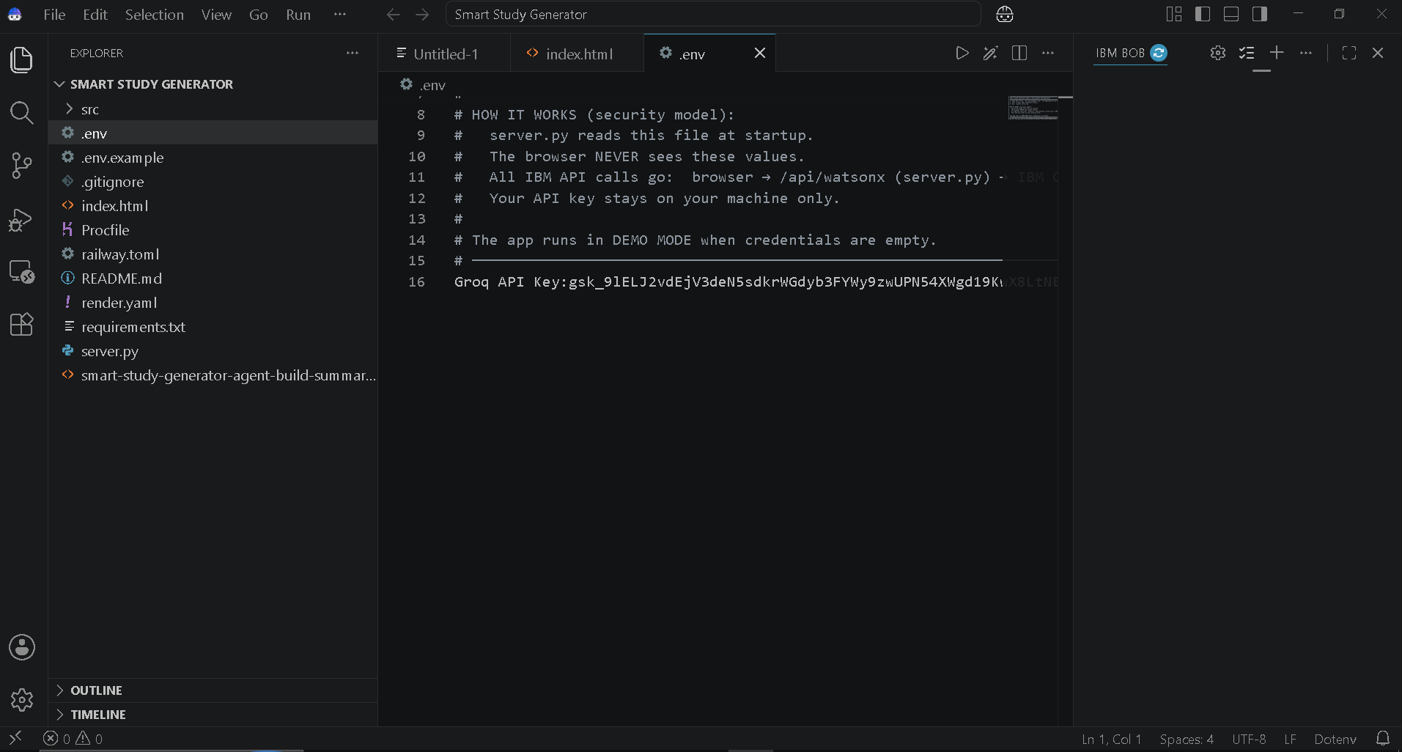
Required Files created using IBM bob -

Slide 7
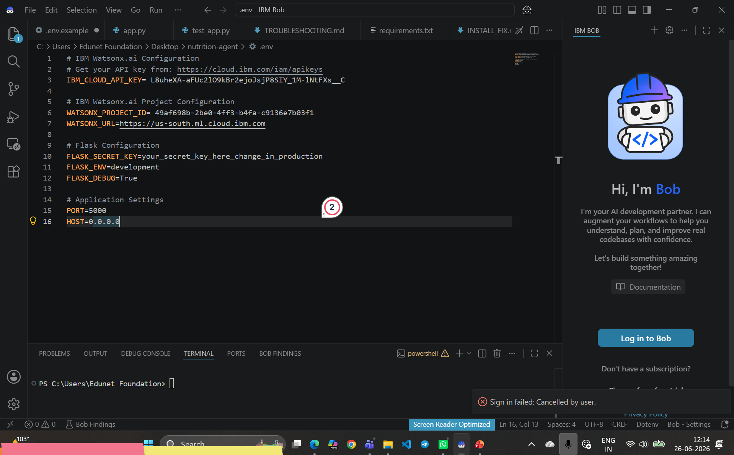
IBM Bob Screenshots:

Slide 8
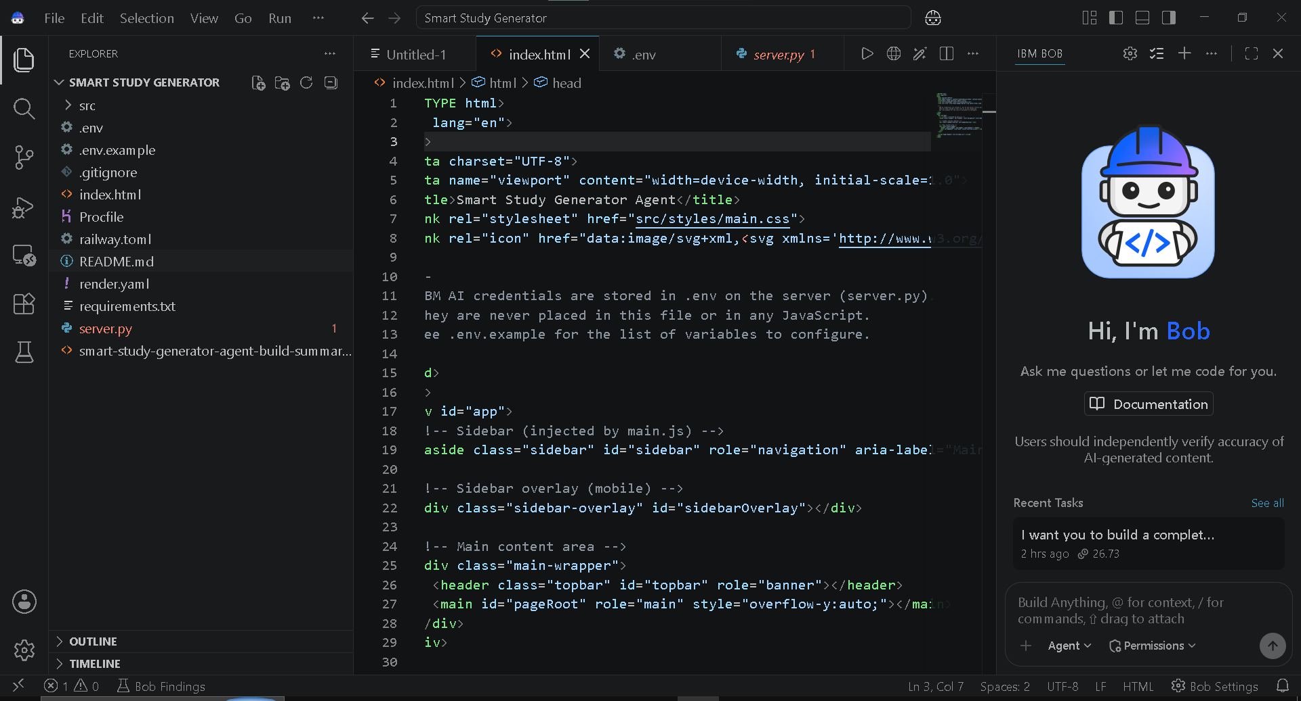

Slide 9

Role of Agentic AI in the solution
Agentic AI acts as the decision-making and action layer of the Smart Study Generator. Instead of simply answering student questions, it understands the student's situation, decides what needs to be done, and takes action automatically.
Analyzes Student Data: Understands syllabus, study material, quiz results, progress, and learning goals.
Identifies Priorities: Detects weak areas and important topics that need more attention.
Creates Study Plans: Automatically builds and adjusts a personalized study schedule.
Generates Learning Content: Produces summaries, flashcards, quizzes, and revision material based on the student's needs.
Monitors & Adapts: Continuously tracks performance and changes the study plan when the student's performance changes.
Provides Proactive Recommendations: Tells the student what to study next, what to revise, and where to focus without requiring the student to ask every time.

Slide 10
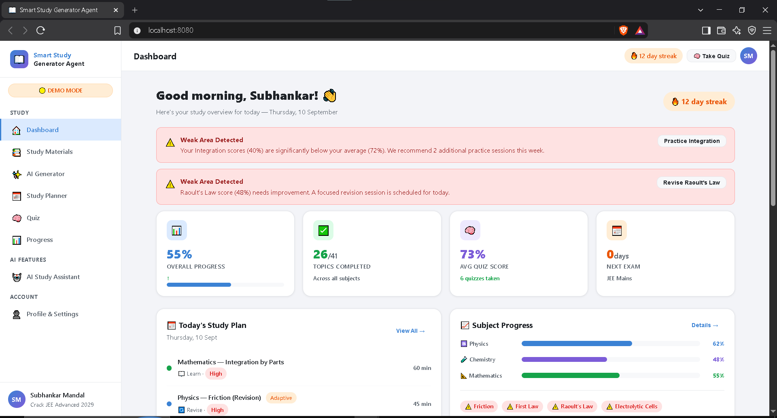
Project Output Screenshot
·
·
·

Slide 11
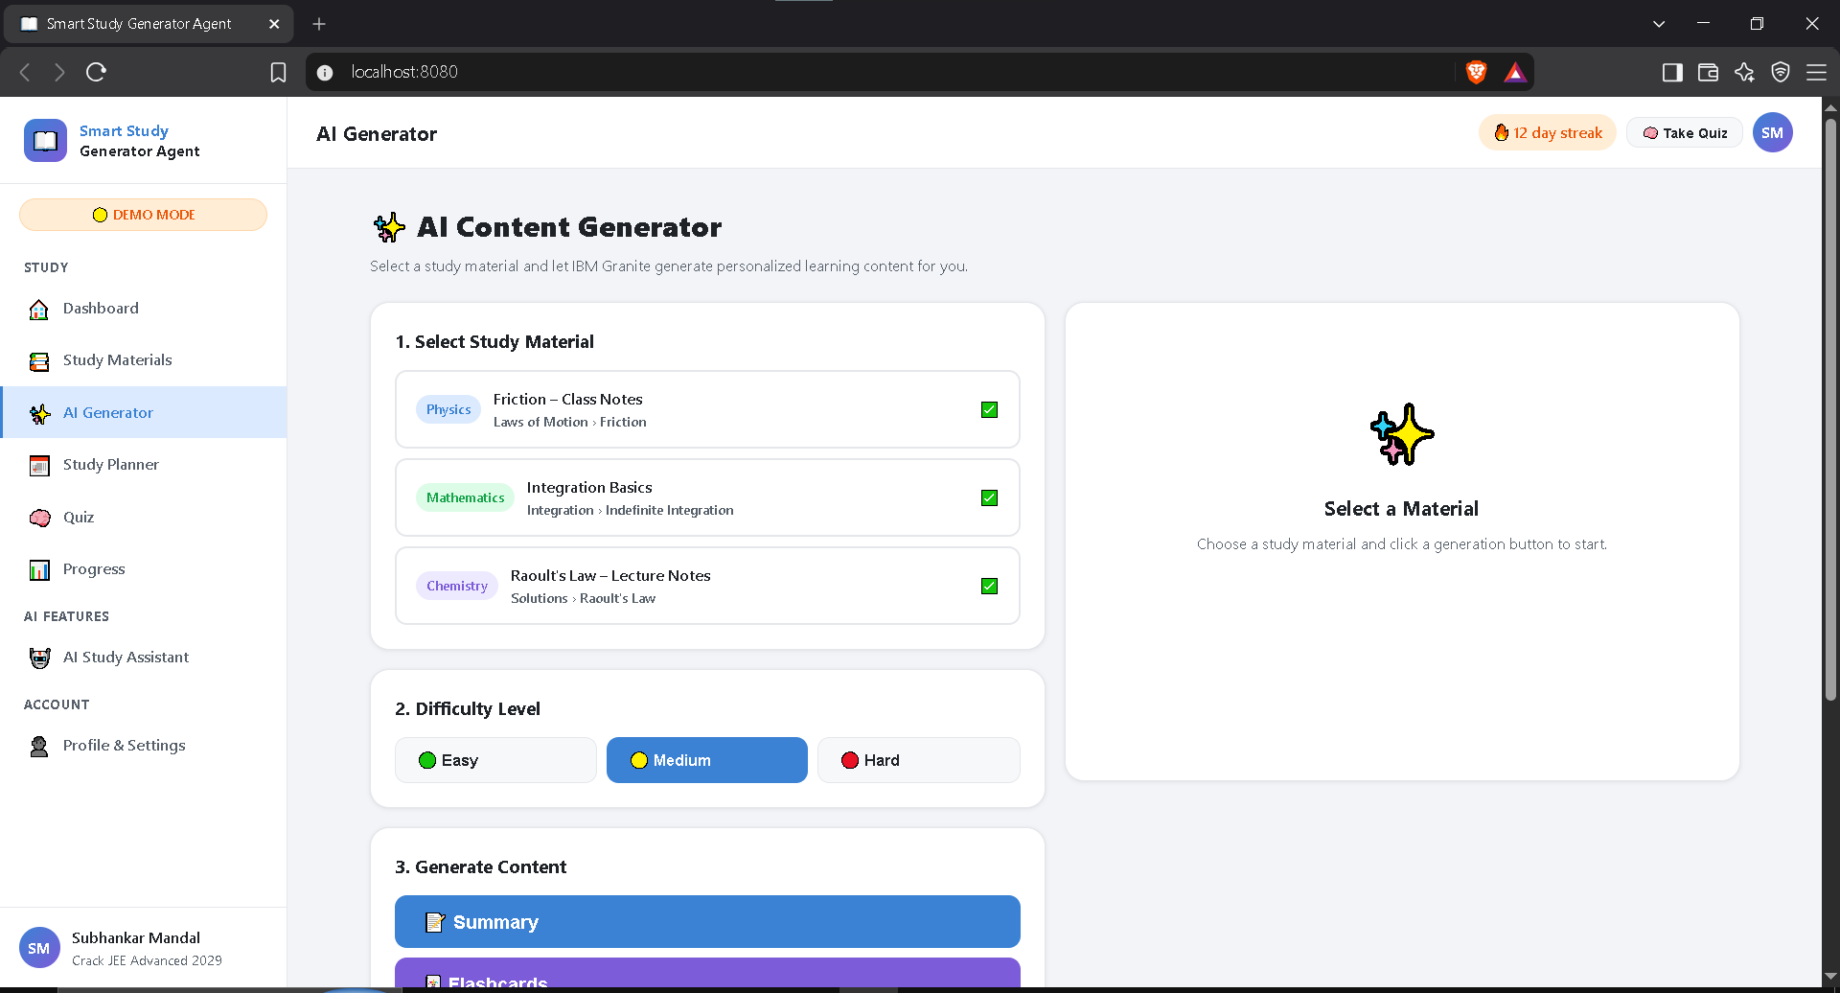
Project Output Screenshot
Please put IBM Bob output screenshots with 2-3 prompts.
You can take 2-3 more slides for each screenshot
·
·
·

Slide 12
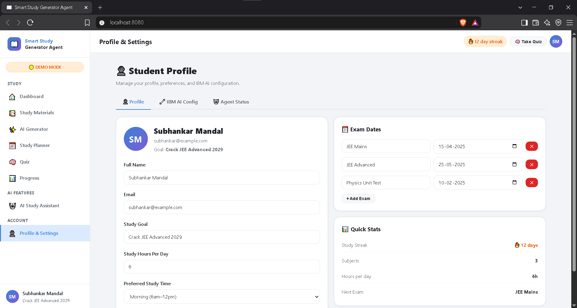
Project Output Screenshot
·
·
·

Slide 13
Novelty and Uniqueness
Personalized for Every Student: The Al understands each student's progress, strengths, and weak areas instead of giving the same plan to everyone.
Works with Different Types of Content: Students can use notes, PDFs, images, or voice/text questions, making learning more flexible.
Study Plan That Changes Automatically: The plan adapts based on quiz performance, progress, and upcoming goals.
Al That Takes Initiative: It doesn't just wait for questions-it can suggest what to study, revise, or practice next.
Everything in One Place: Study materials, summaries, quizzes, planning, recommendations, and progress tracking are connected in a single platform.
Complete Learning Cycle:
Study → Practice → Analyze → Improve →Repeat

Slide 14
Git Hub Link
https://github.com/SubhankarMan1/IBM-BOB
·
·
·

Slide 15
Future Scope
Smarter Personalization: The system can learn more about each student's learning pattern and provide increasingly accurate study plans.
Voice-Based Learning: Students could interact with the system through natural voice conversations for a more interactive learning experience.
Multiple Languages: Support for regional languages can make personalized learning accessible to more students.
Advanced Performance Prediction: The system can identify learning gaps earlier and suggest timely revision and practice.
Integration with Educational Platforms: It can connect with schools, colleges, LMS platforms, and digital classrooms.
Al Tutor Expansion: The platform can evolve into a 24/7 Al tutor that explains concepts, conducts practice sessions, and guides students.
Collaborative Learning: Future versions could support group study, peer learning, and shared learning resources.
Scalable Education Solution: The same system can be adapted for different subjects, academic levels, competitive exams, and professional learning.
·
·
·

Slide 16
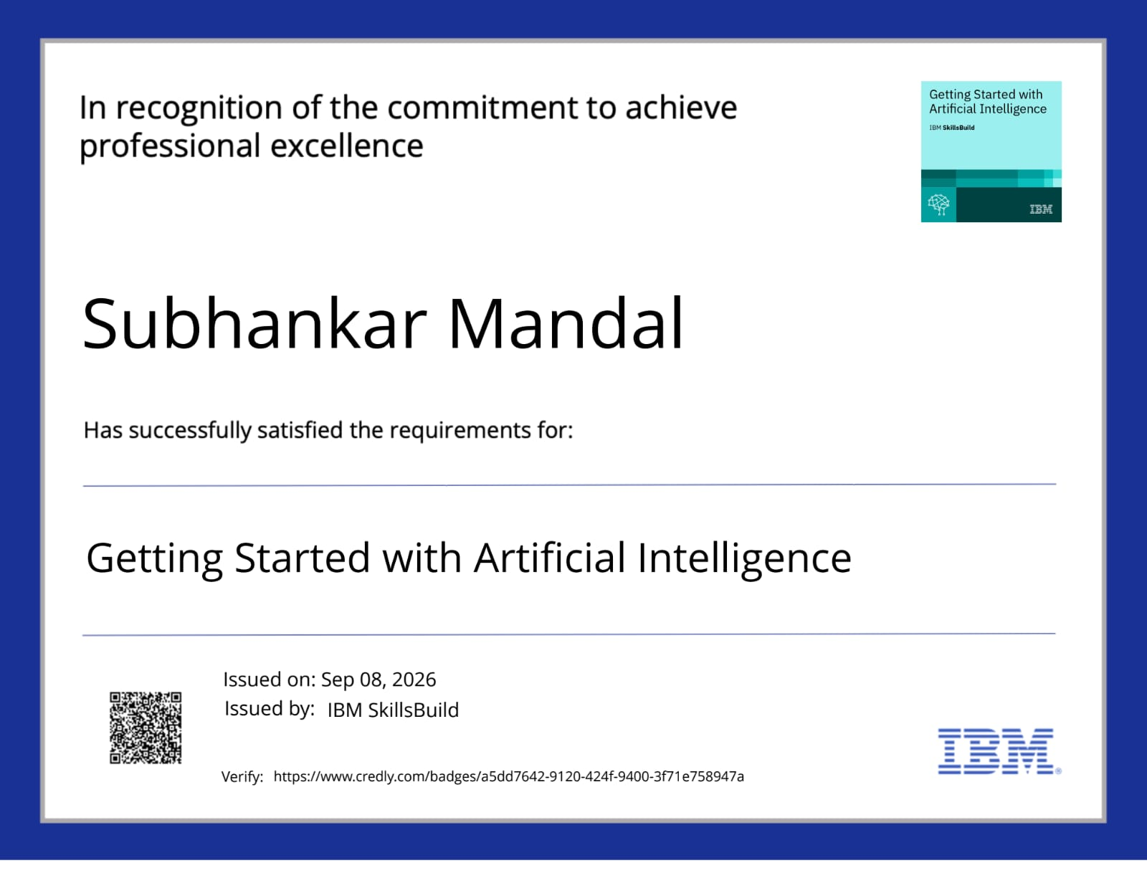
Certificates Earned:

Slide 17
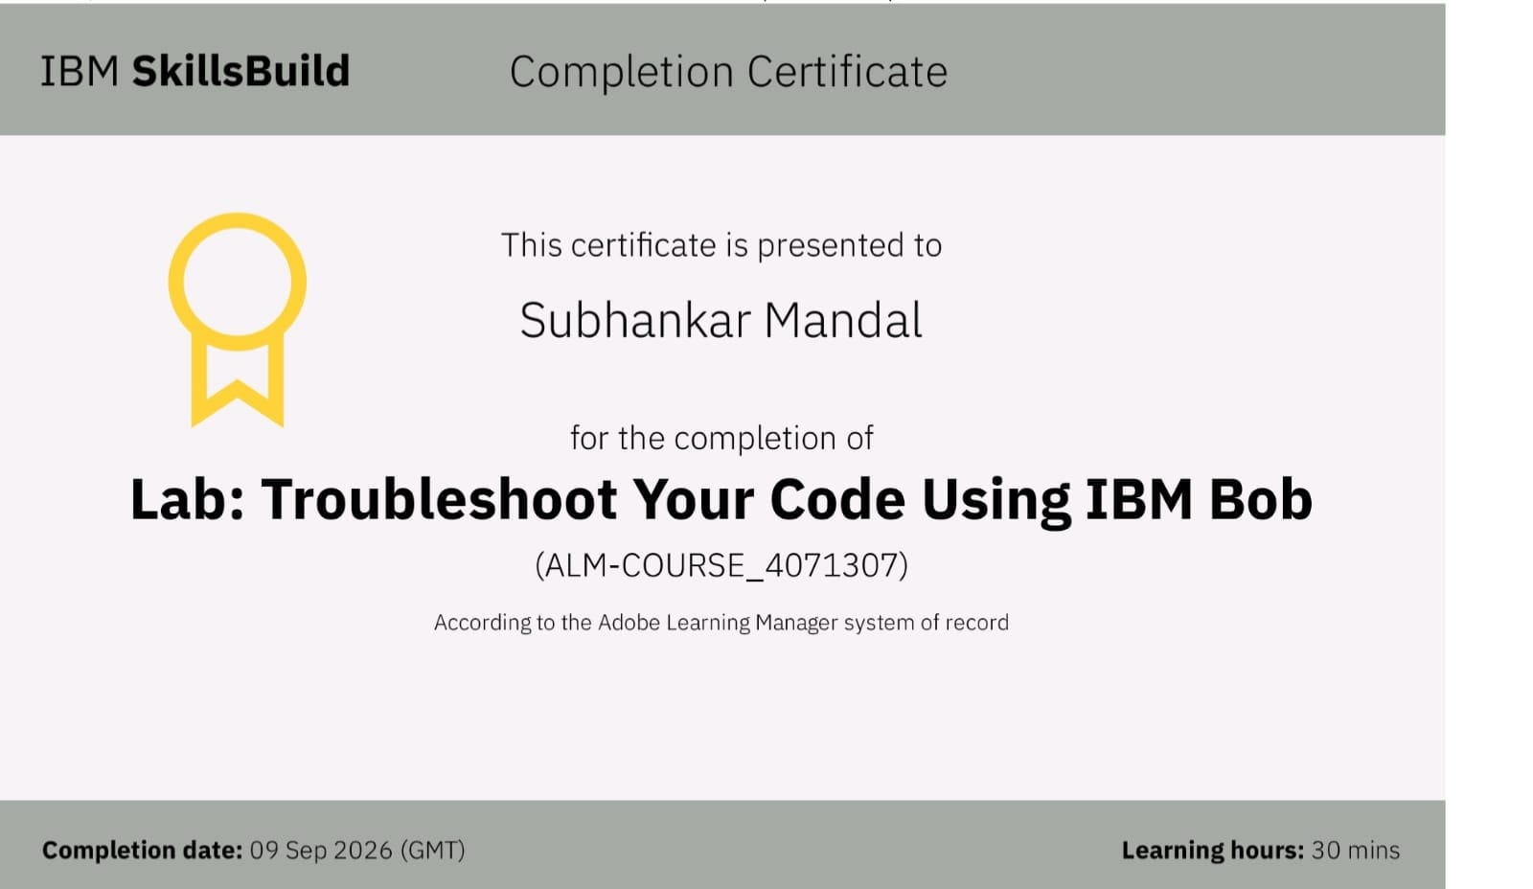
Certificates Earned:​

Slide 18
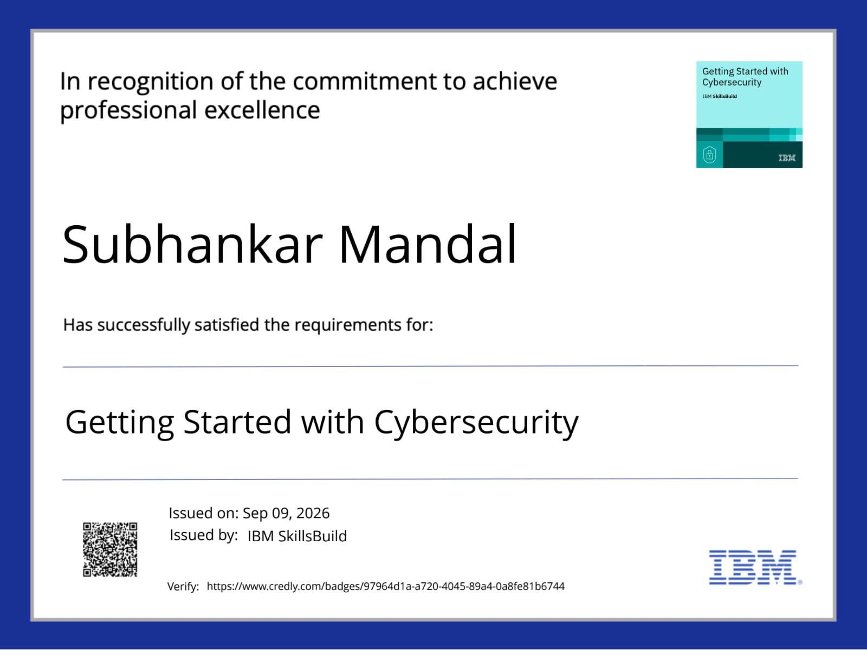
Certificates Earned:​

Slide 19


